Slide 1
Physics-Informed Neural Networks for Mechanics
Data-driven solutions and discoveries: a PyTorch reproduction of Zhang, Chen & Yang (Stanford CS229)
Prakruti Prasanna Bhat (PES1UG24CS330)
Pushkar S Kulkarni (PES1UG24CS350)

Slide 2
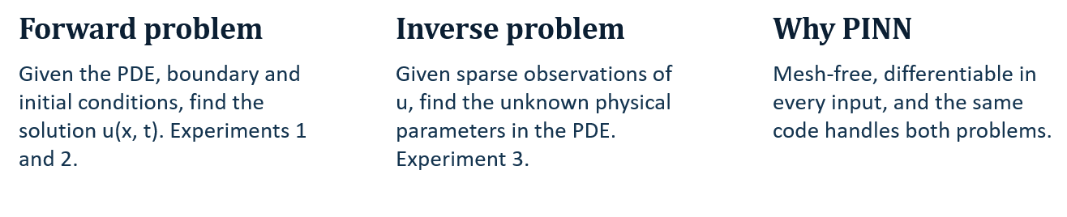
Solving mechanics PDEs with a neural network
Mechanics is governed by conservation laws, which become differential equations. A PINN puts the equation itself into the training loss, so the network needs few or no labelled data.

Slide 3
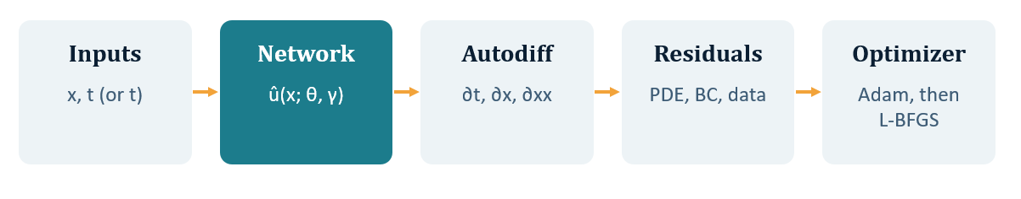
How a PINN is trained
L(θ, γ) = wf·Lf + wb·Lb + wd·Ld
•Lf: mean squared PDE residual at random collocation points
•Lb: boundary and initial-condition mismatch
•Ld: mismatch with observations (inverse problem only); γ = unknown parameters

Slide 4
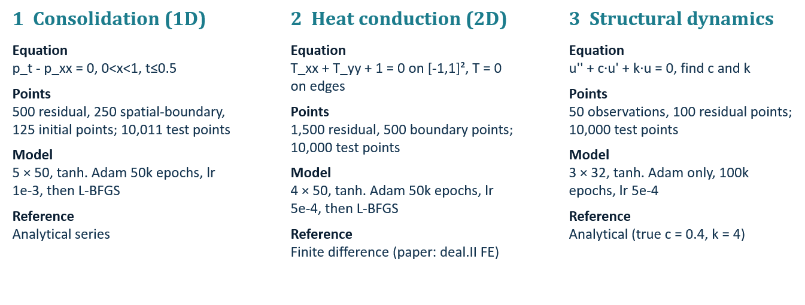
Three experiments, no external dataset
Data: points are sampled from the domain; Experiment 3 observations are noiseless values generated from the analytical solution.

Slide 5
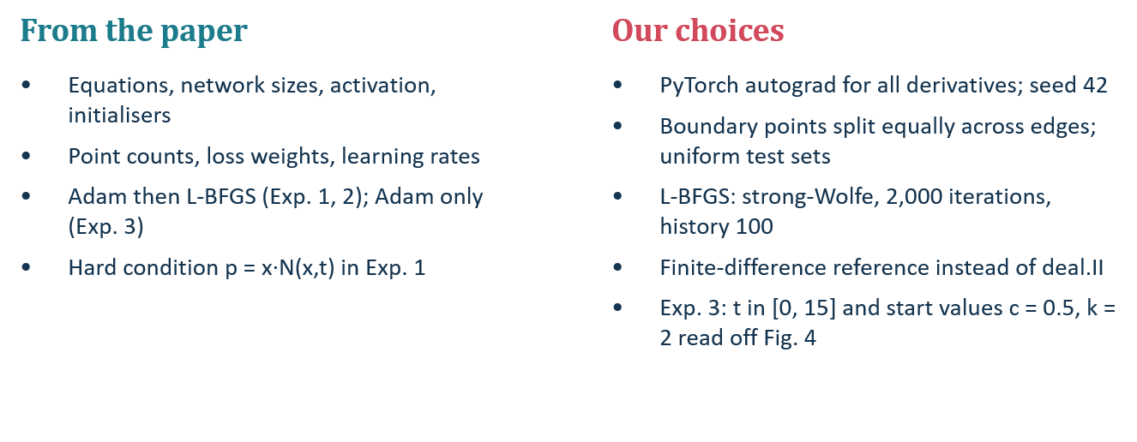
Implementation: paper-fixed vs our choices

Slide 6
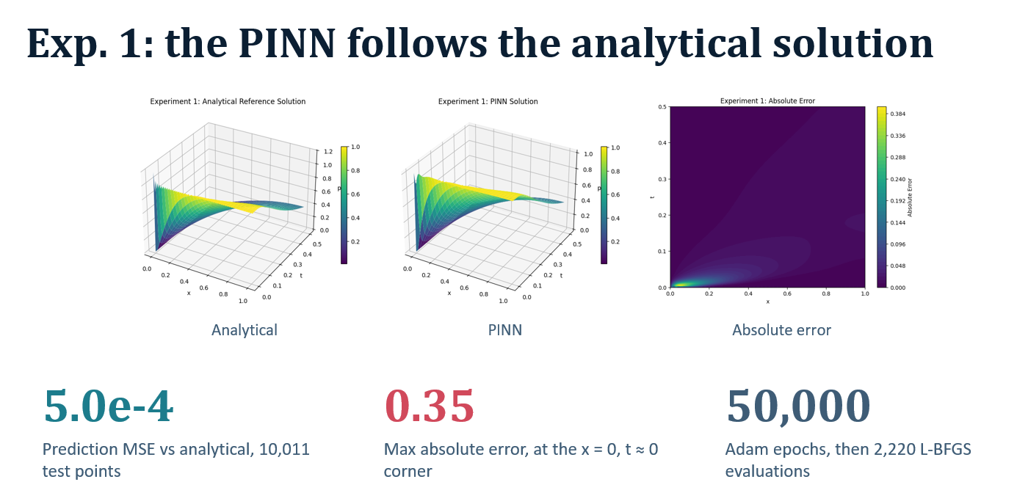

Slide 7
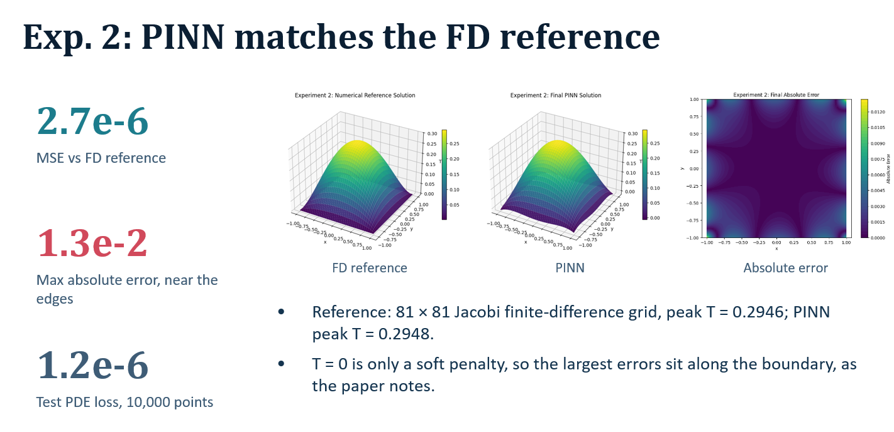

Slide 8
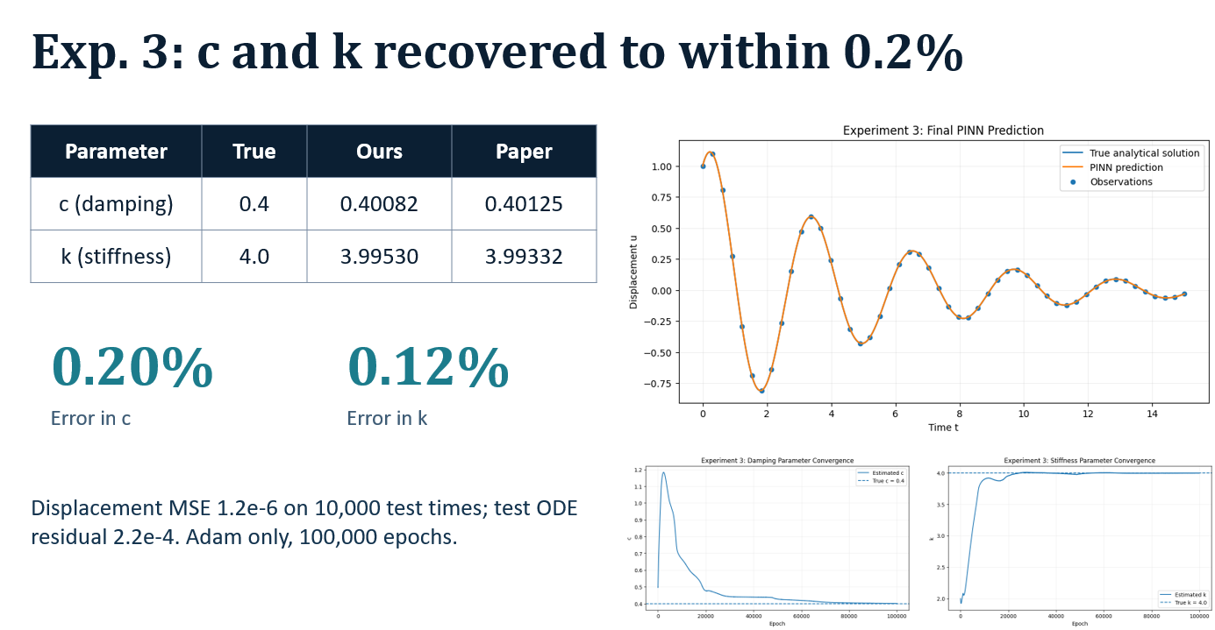

Slide 9
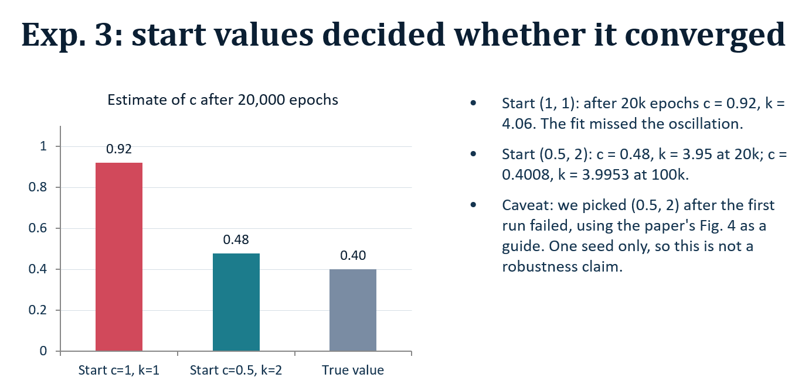

Slide 10
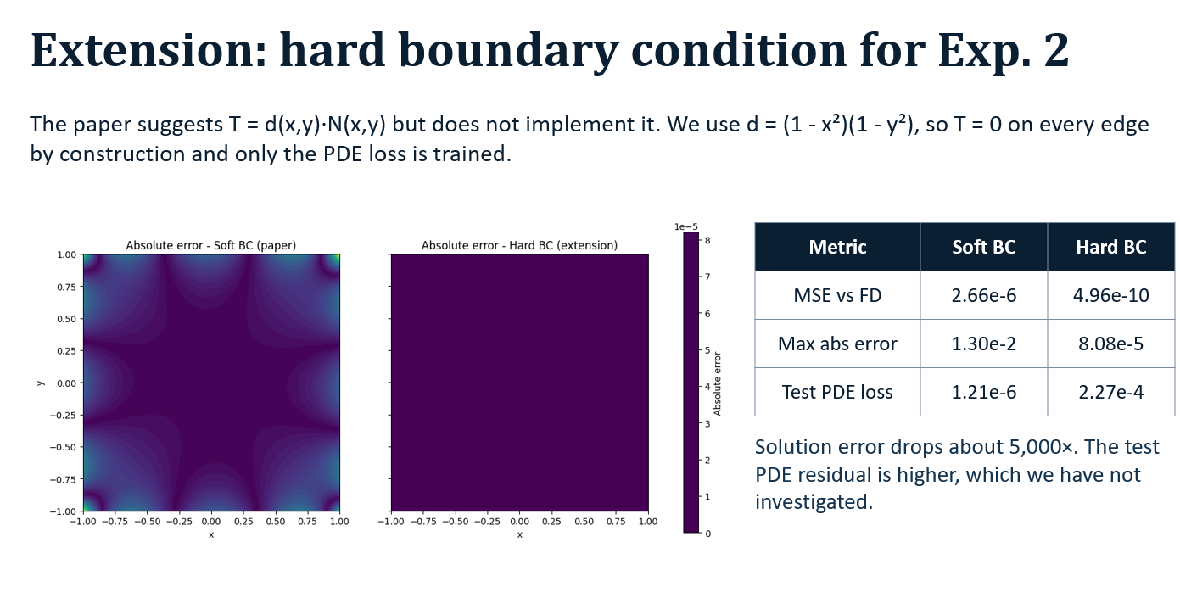

Slide 11
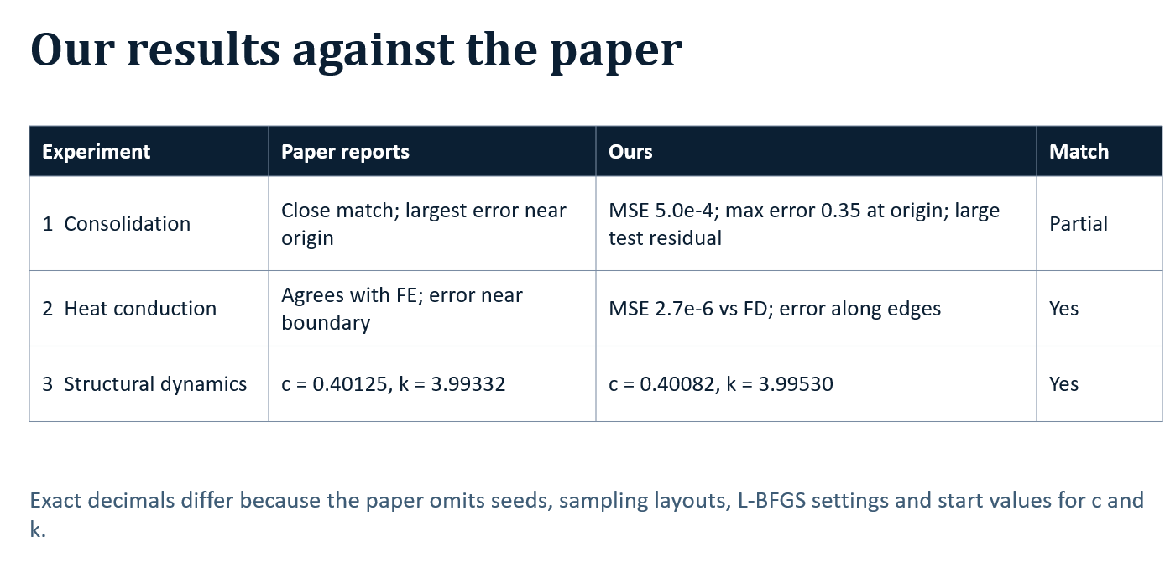

Slide 12
Conclusions
What worked
Limits and next steps
•One loss-based method solved a PDE in 1D and 2D and identified parameters from data.
•Inverse problem matched the paper to three decimals.
•Hard boundary condition cut Exp. 2 error about 5,000×.
•Exp. 1 residual blows up at the origin; try adaptive
sampling there.
•Exp. 3 is sensitive to start values; test several seeds.
•Paper's own next step: coupled poromechanics
equations.

